Slide 1


Slide 2

Xamarin.iOS - Intro
Miljenko Cvjetko Xamarin, HolisticWare

Slide 3


Slide 4


Slide 5
Objectives
Development tools
Visual Studio and Xamarin.Studio
Xcode
Application deconstruction and launch
Adding UI elements

Slide 6

Prerequisites for iOS development
Mac with MacOSX
iOS SDK with Xcode

Slide 7
Prerequisites for iOS development
Xamarin tools
MacOSX
Xamarin.Studio
Xamarin.iOS
Windows
Visual Studio
Xamarin.iOS
Xamarin Build Host on Mac

Slide 8
Xamarin.iOS -Components
Compile time components
C# compiler for Mac (mono project)
Native compiler (AOT) and linker
Core .net libraries
Base Class Libraries BCL
Runtime components
Runtime services (GC, type checking, …)
Core .net libraries

Slide 9
Xamarin.iOS - IDE
IDE
Mac OSX
Xamarin.Studio
Xcode
Windows
Visual Studio
Xamarin.Studio is IDE AddIn/Extension

Slide 10
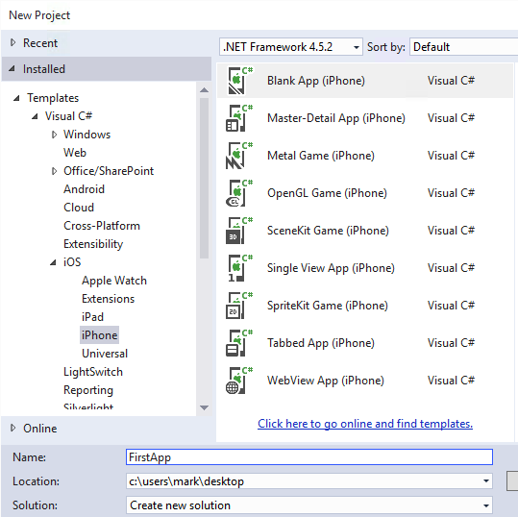
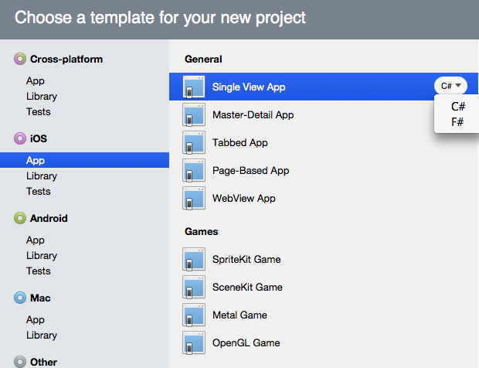
Xamarin.iOS - Templates
IDE project templates
Visual Studio
Xamarin Studio

Slide 11
Xamarin.iOS – Project Creation
Project Creation Templates
Libraries
iOS library
iOS Binding Library
Apps
Single View – 1 View/ViewConotroller (UIView/UIViewConotrller)
Master Detail – list (TableView) with Details screen usually UINavigationController
Page Based – multi screen swiping
WebView
Tabbed App – TabBar for multiple pages and navigation

Slide 12
Xamarin.iOS – App Launching
Application Launching/Testing
Simulator
Part of iOS SDK on Mac
Device
registered developer Apple account to deploy to a device
register each device and get a set of signing certificates from Apple
Apps must be signed with an Apple-supplied certificate
Devices must be registered with Apple developer portal

Slide 13
Xamarin.iOS – App Structure 1
DEMO
Create project
Explore elements

Slide 14
Xamarin.iOS – App Structure 2
Project structure
File System
UI definition files: Storyboards and XIBs (NIBs)
Code: c# files
Assets, Bundle Resources: images
Metadata: *.plist files (Info.plist, Entitlements.plist)
MVC Pattern Model View Controller
UIViewController
Delegates and Protocols

Slide 15
Xamarin.iOS – App Structure 3
Code Files
Main.cs
AppDelegate.cs
MVC pattern
UIViewController Root UIViewController
ViewController.cs
ViewController.Designer.cs

Slide 16
Xamarin.iOS – App Structure 4
UI Definition Files
Desginer: built in or Xcode
Storyboards Main.storyboard
XIB files – XML Interface Builder – compiled to NIB UIViewController UIView
C# files

Slide 17
Xamarin.iOS – App Structure 5
MVC Pattern
UIViewController.cs screen definition, each screen - Controller
UIViewController.Designer.cs
Connecting UI elements in Designer with the code
Attributes - PInvoke

Slide 18
Xamarin.iOS – User Interface 1
Screens
UIViewController
Manages
UIViews
UIViewConotrllers
Composition
Superviews/parent View UIView
Subviews/children Views – UIView

Slide 19
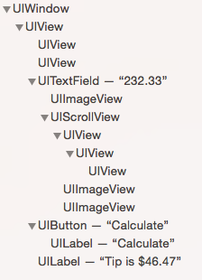

Xamarin.iOS – User Interface 2

Slide 20
Xamarin.iOS – User Interface 3
View Lifecycle
UIViewController
Notified when root View is loaded, shown and hidden
public partial class ViewController : UIViewController {
...
public override void ViewDidLoad() { base.ViewDidLoad(); this.View.BackgroundColor = UIColor.Yellow;
}
}

Slide 21
Xamarin.iOS – User Interface 4
LoadView
ViewDidLoad
Method | Called when
LoadView | Creates the root view
ViewDidLoad | View created / loaded
ViewWillAppear | View about to be shown
ViewDidAppear | View has been rendered
ViewWillDisappear | View about to be hidden
ViewDidDisappear | View has been hidden
ViewWillAppear
ViewDidDisappear
ViewDidAppear
ViewWillDisappear

Slide 22
Xamarin.iOS – User Interface 5
UI programatically through code
public override void ViewDidLoad() {
...
var label = new UILabel() { ... } var entry = new UITextField() { ... } var button = new UIButton() { ... }
View.AddSubview(label); // add one view
// or View.Add(label)
View.AddSubviews(entry, button); // add multiple views
}

Slide 23
Xamarin.iOS – User Interface 6
UIView : IEnumerable iteration, no LINQ (not IEnumerable<T>)
void RemoveAllContent() { foreach (UIView subview in View)
{
// Remove from the parent view subview.RemoveFromSuperview(); } }

Slide 24
Xamarin.iOS – User Interface 7
UITextView – hide keyboard, loose focus
UITextField emailEntry = ...;
...
void HideKeyboard()
{
emailEntry.ResignFirstResponder();
}

Slide 25
Xamarin.iOS – User Interface 8
Memory Handling
public partial class ViewController : UIViewController {
UIImageView backgroundImage;
...
protected override void Dispose(bool disposing) { base.Dispose(disposing);
if (disposing) {
backgroundImage.Dispose();
backgroundImage = null;
}
}
}

Slide 26
Xamarin.iOS
Q&A

Slide 27


Ne zaboravite ispuniti upitnike.
Čekaju vas vrijedne nagrade!

Slide 28


Slide 29
Xamarin.iOS – DEMO
DEMO
Project Structure
Project creation
Files
UI definition
in code
in storyboard
in storyboards
in XIB

